Slide 1

MLA0104 – AI
Technical Seminar and Presentation
INDUCTIVE SENSOR
PRESENTED BY:
S.Roshni(192525185)
GUIDED BY: Dr. Prakash Mathialagan ,
Professor, SIMATS Engineering

Slide 2
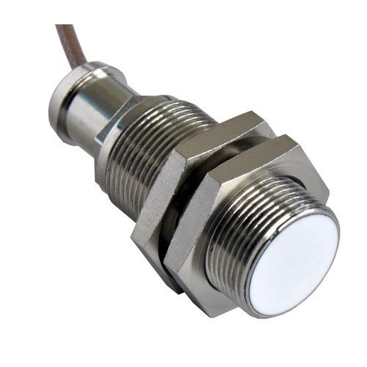
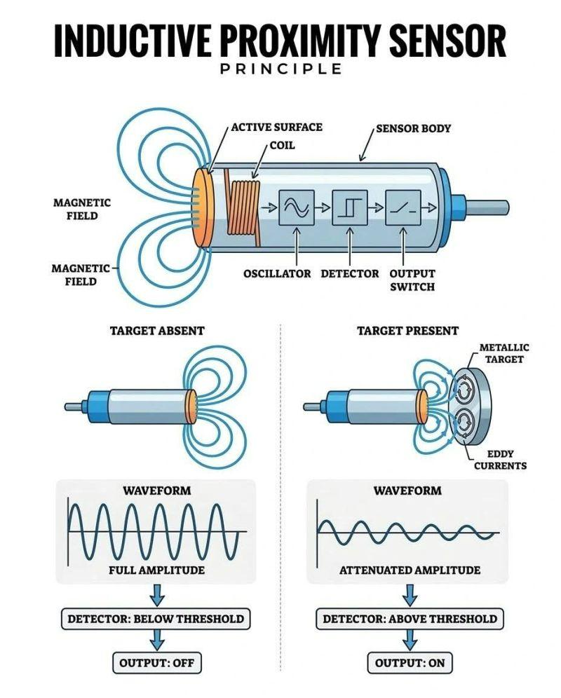
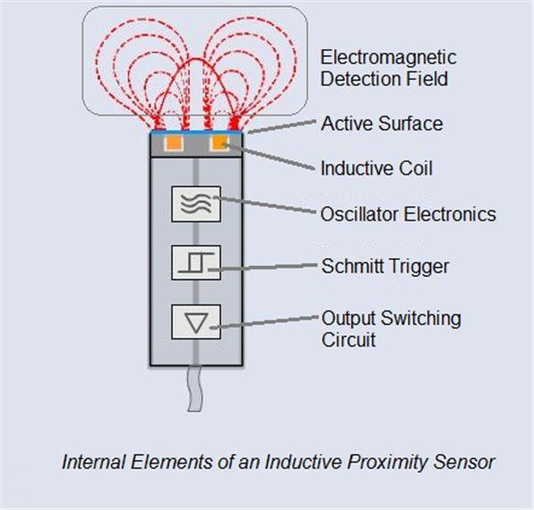
Sensor Image
Inductive Sensor: An inductive sensor is a non-contact sensor used to detect metallic objects. It works using an electromagnetic field generated by a coil.

Slide 3
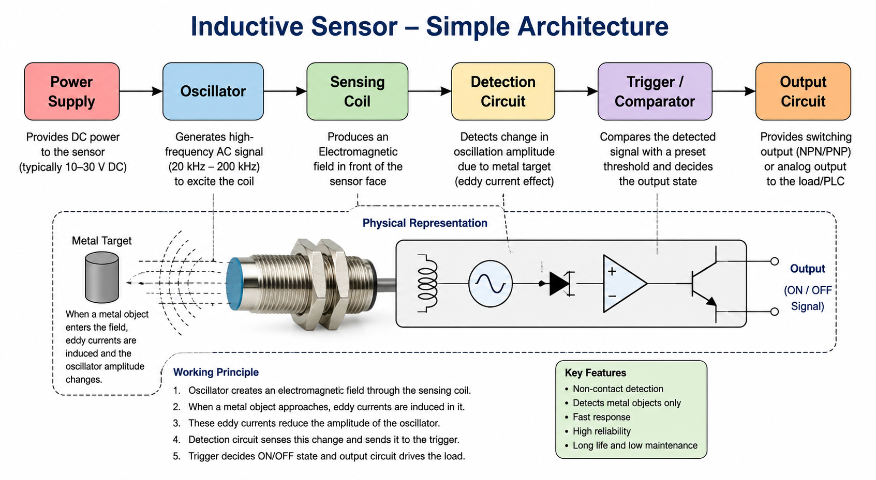
Components of an Inductive Sensor
Main Components
1. Sensing Coil
Produces the electromagnetic field.
Detects changes when a metal object approaches.
2. Oscillator
Generates a high-frequency alternating signal.
Supplies the signal to the sensing coil.
3. Detection Circuit
Detects the change in oscillator amplitude caused by a metal target.
4. Trigger / Comparator
Compares the detected signal with a preset threshold.
Decides whether the metal object is present.
5. Output Circuit
Output can be connected to a PLC, Arduino or control system.

Slide 4
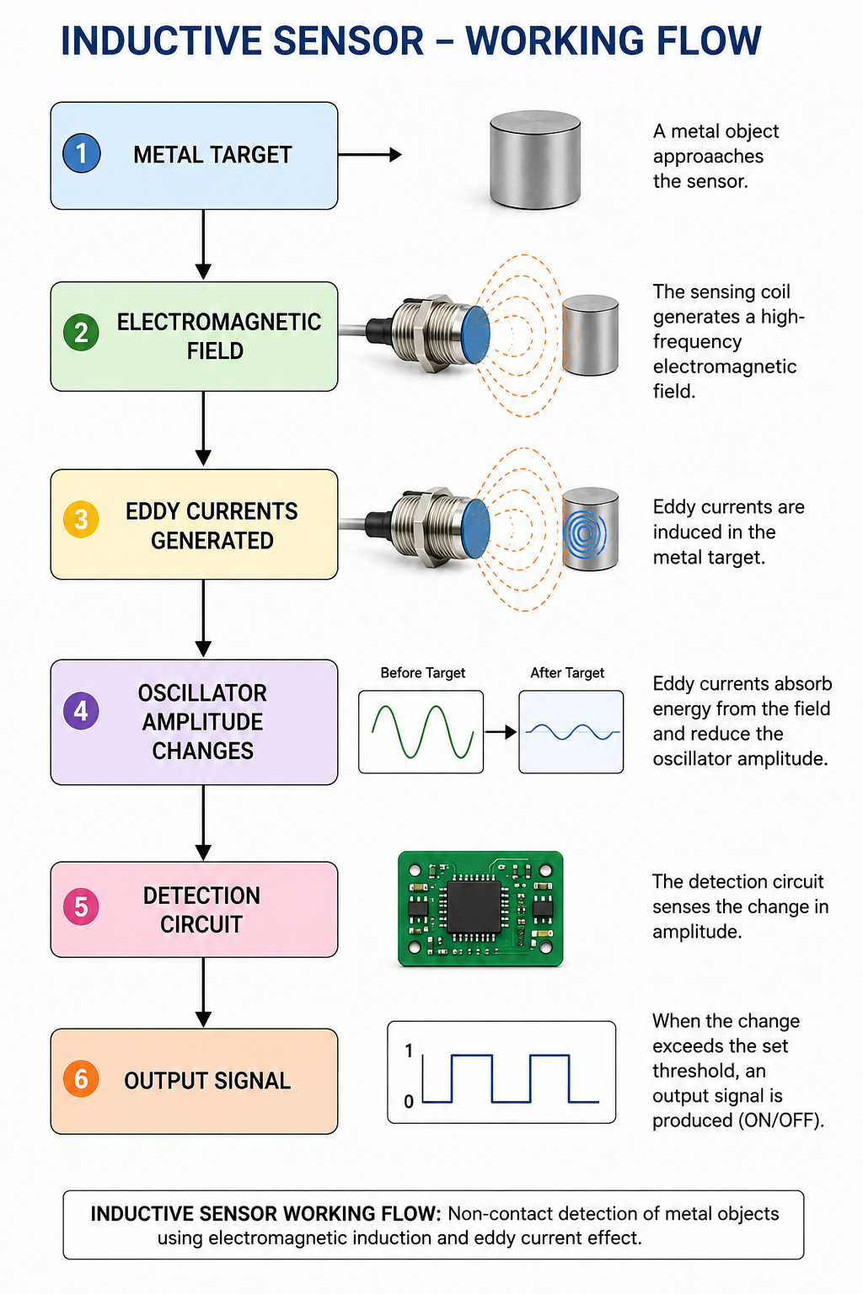
How Does an Inductive Sensor Work?
The oscillator produces a high-frequency electrical signal.
The signal creates an electromagnetic field around the sensing coil.
When a metal object enters this field, eddy currents are generated inside the metal.
These eddy currents absorb energy from the electromagnetic field.
The oscillator's amplitude changes.
The detection circuit senses this change.
The output circuit produces an ON/OFF signal.

Slide 5
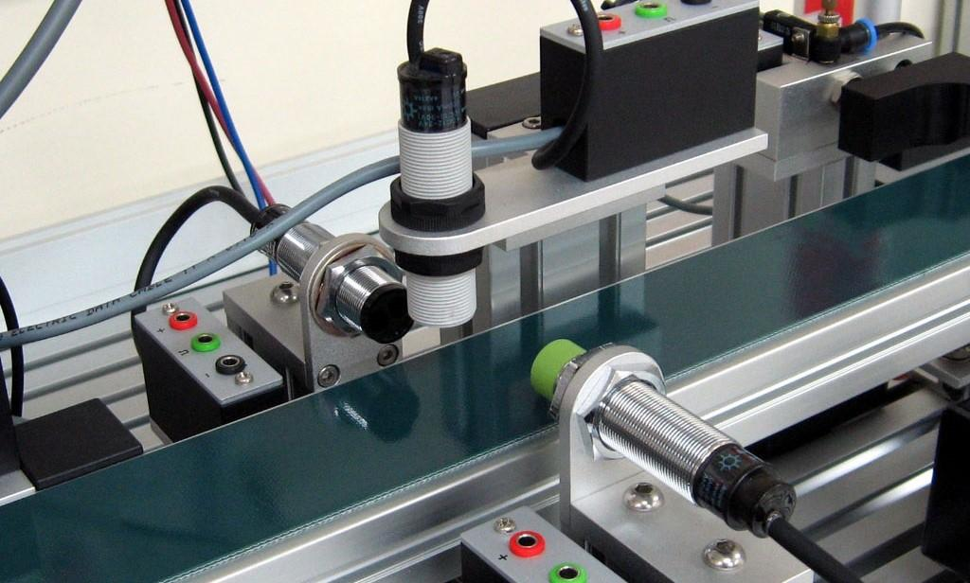
Where Is an Inductive Sensor Used?
🏭 Industrial Automation
Used to detect the presence and position of metal components.
🤖 Robotics
Used to identify metallic parts and determine their position.
⚙️ CNC Machines
Used for tool and machine-position detection.
🚗 Automotive Industry
Used for detecting metallic components and machine positions.
📦 Conveyor Systems
Used for counting and detecting metal objects moving on conveyors.
🔧 Manufacturing
Used for object detection, position sensing and automatic quality-control systems.

Slide 6
Why Is an Inductive Sensor Used?
Non-contact detection – no physical contact is required.
Fast response – suitable for high-speed automation.
High reliability – fewer mechanical parts means less wear.
Good durability – suitable for industrial environments.
Accurate metal detection – reliably detects conductive objects.
Low maintenance – no mechanical contact with the target.
Easy automation integration – can be connected to PLCs and controllers.

Slide 7
How Is It Used with AI/ML?
The inductive sensor can provide continuous sensor data to an AI/ML system.
Inductive Sensor → Data Collection → Signal Processing → ML Model → Prediction
Example
In a factory, the sensor detects machine components.
Normal signal → Normal operation
Unusual signal → Possible fault
Repeated abnormal signals → Predictive maintenance alert
Therefore, AI/ML can enhance the sensor from simple metal detection into an intelligent monitoring system.

Slide 8
CONCLUSION
Inductive sensors are fast, reliable and non-contact sensors mainly used for metallic-object detection.
Their integration with AI/ML enables intelligent sensing, anomaly detection and predictive maintenance, making them highly useful for modern smart manufacturing and Industry 4.0.

